Slide 1
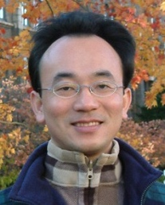
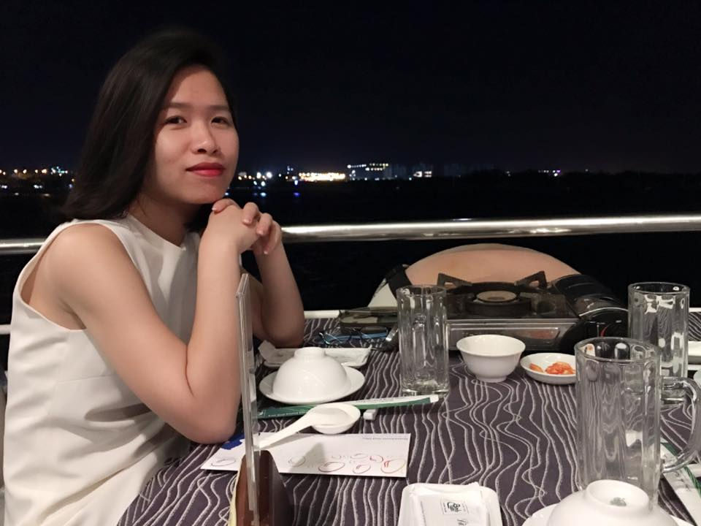


Using NLP with Transformers Analyze customer satisfaction for Uber Eats and Food Panda apps
Professor Min-Yuh Day
soPHIe
Artificial Intelligence for Text Analytics Course
Institute of Information Management, NTPU
GMBA in Finance, NTPU
Student’s ID: 710937132
31 May 2022
1

Slide 2



Food Delivery Apps?
2

Slide 3

Food is a vital part of our day-to-day life. Without it, we won't survive in this world
3

Slide 4

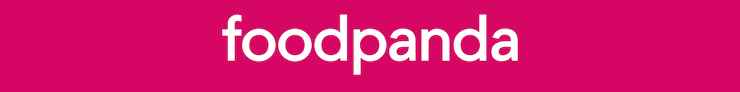


why is Uber Eats and Food panda Apps
4

Slide 5

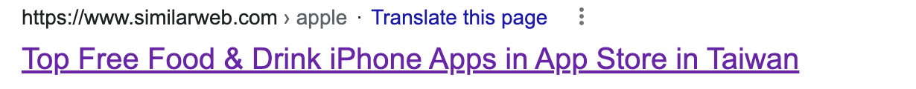
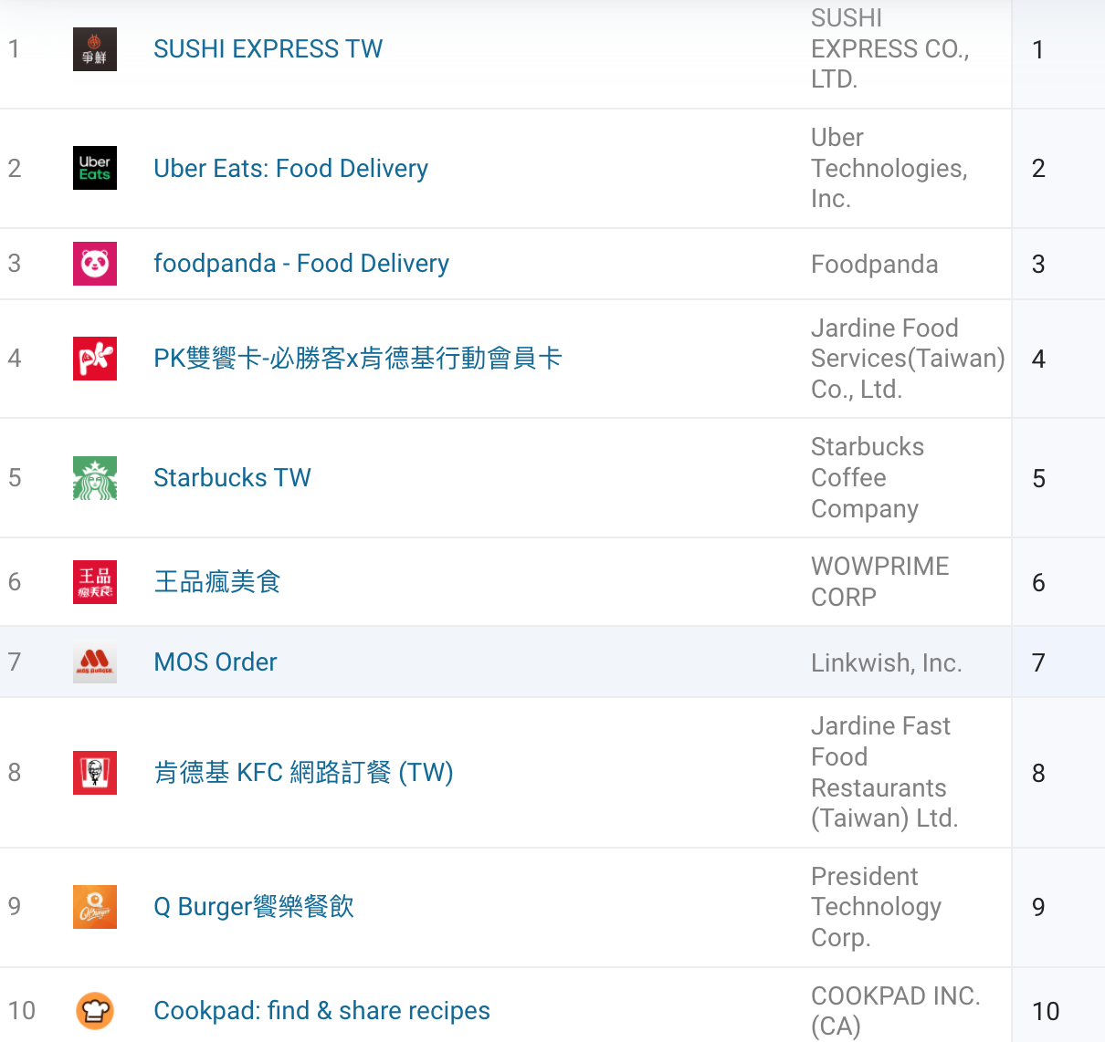
OUR COMPANY
You can give a brief description of the topic you want to talk about here. For example, if you want to talk about Mercury, you can say that it’s the smallest planet in the entire Solar System

Slide 6
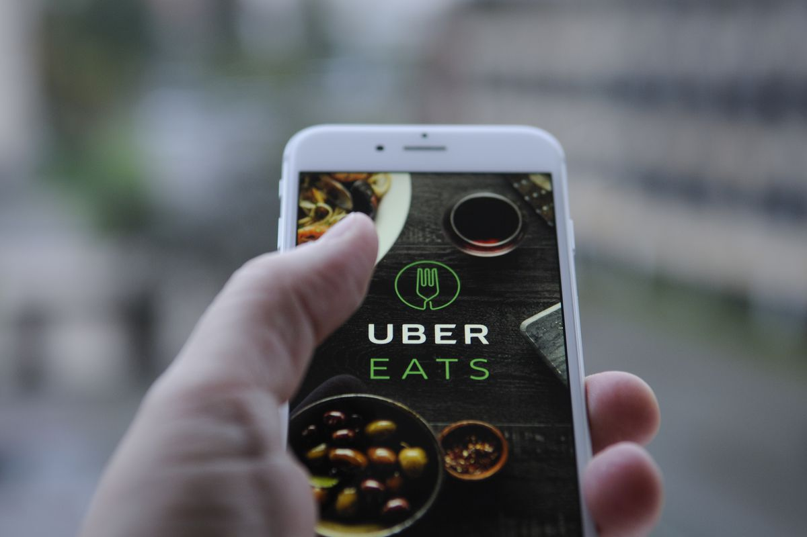
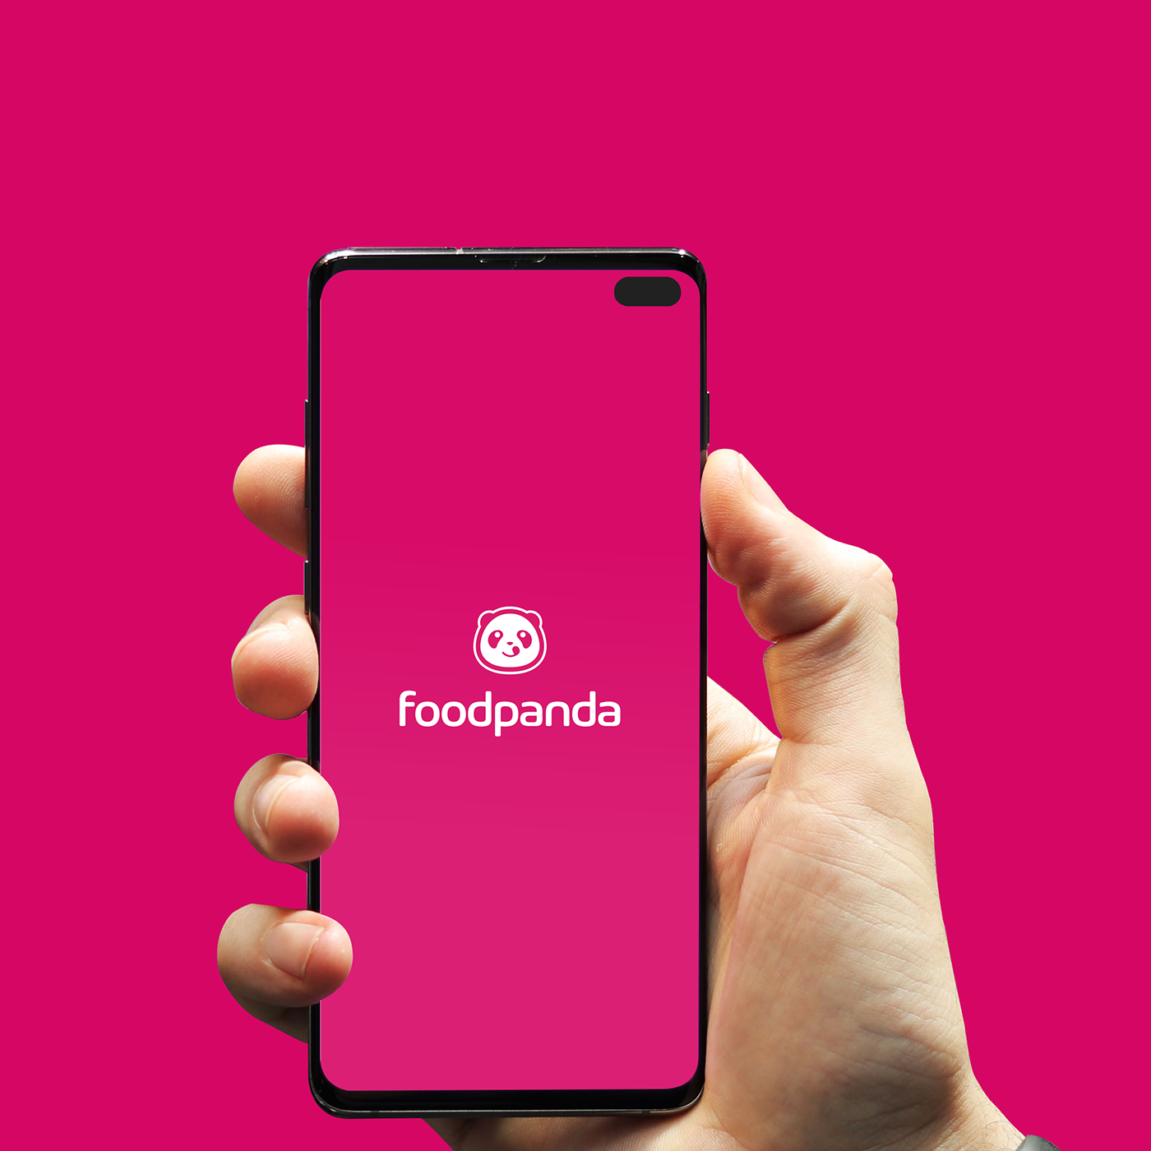
THEM
US
Mercury is the closest planet to the Sun and the smallest one in the Solar System—it’s only a bit larger than the Moon
Venus has a beautiful name and is the second planet from the Sun. It’s hot and has a poisonous atmosphere
6

Slide 7
contents
01
02
BACKGROUND
METHODOLOGY
03
04
RESULTS
Implications
7

Slide 8

01
BACKGROUND
The background of the research
8

Slide 9
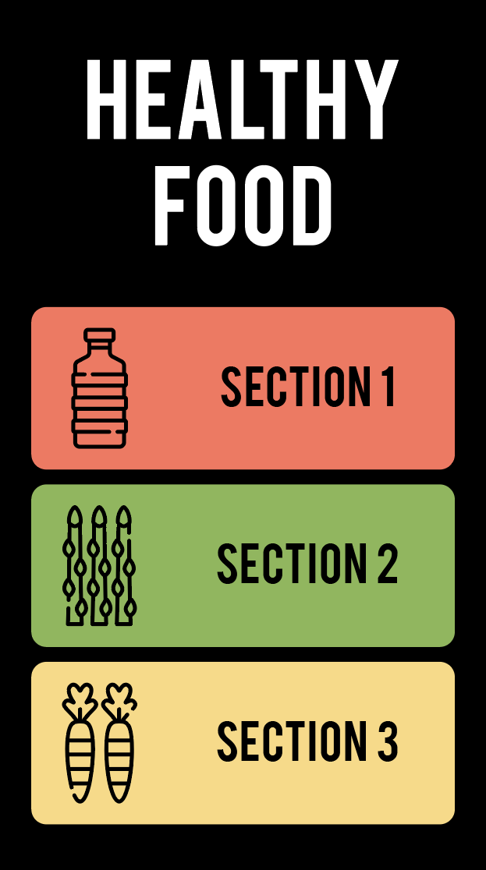
BACKGROUND
Understanding customer behavior and driving customer satisfaction are necessary for any business to succeed in the competing market. Companies need to be aware of the prevailing customer perceptions to make more accurate and effective plans for product development and marketing.
Collecting customer feedback is a great way for businesses to understand the strengths and weaknesses of their products and services; at the same time quickly grasp the mind and needs of customers to bring them the most perfect products and services.
9

Slide 10
—SOPHIE
Customer feedback is available through multiple channels, specifically through social media, comments...Analyzing such data correctly is critical, as it reveals everything from buying trends to product flaws and provides a significant business advantage. It would further strengthen business opportunity to uncover customer interests, product improvements, and marketing insights. Nowadays, Artificial Intelligence for Text Analytics have become an interesting topic for both research and practice. The impact of this technologies is significant in any area of the business.
10

Slide 11

02
METHODOLOGY
Using NLP with Transformers to analyze 200 comments on Uber Eats and food Panda Apps
11

Slide 12
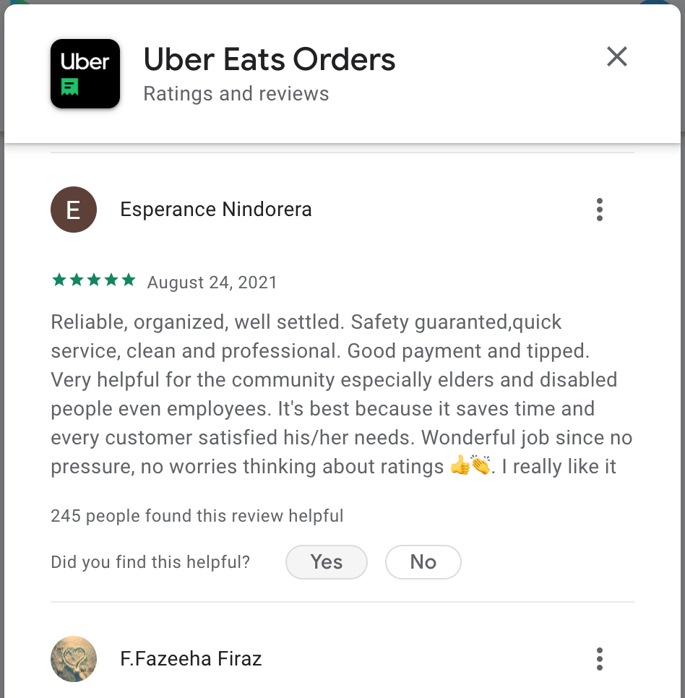
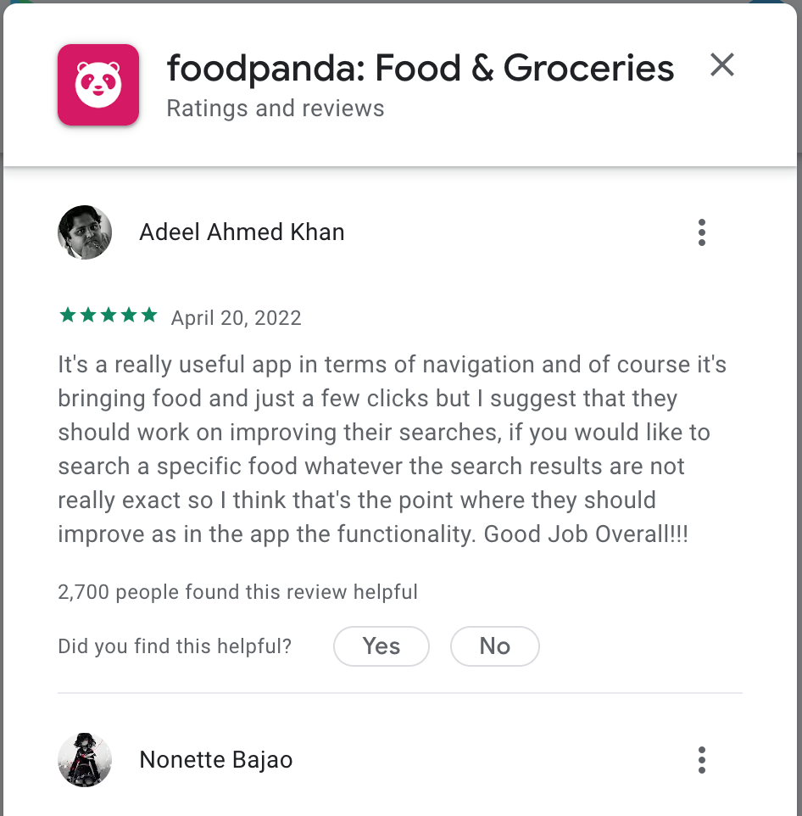
THEM
US
Mercury is the closest planet to the Sun and the smallest one in the Solar System—it’s only a bit larger than the Moon
Venus has a beautiful name and is the second planet from the Sun. It’s hot and has a poisonous atmosphere
12

Slide 13
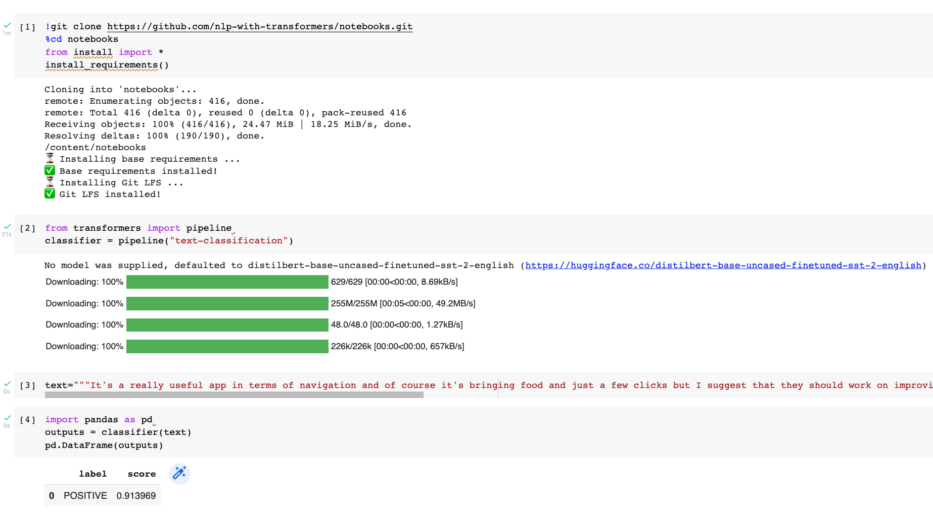

Slide 14
03
RESULTS
100 comments/per App, 200 comments/2 Apps
14

Slide 15
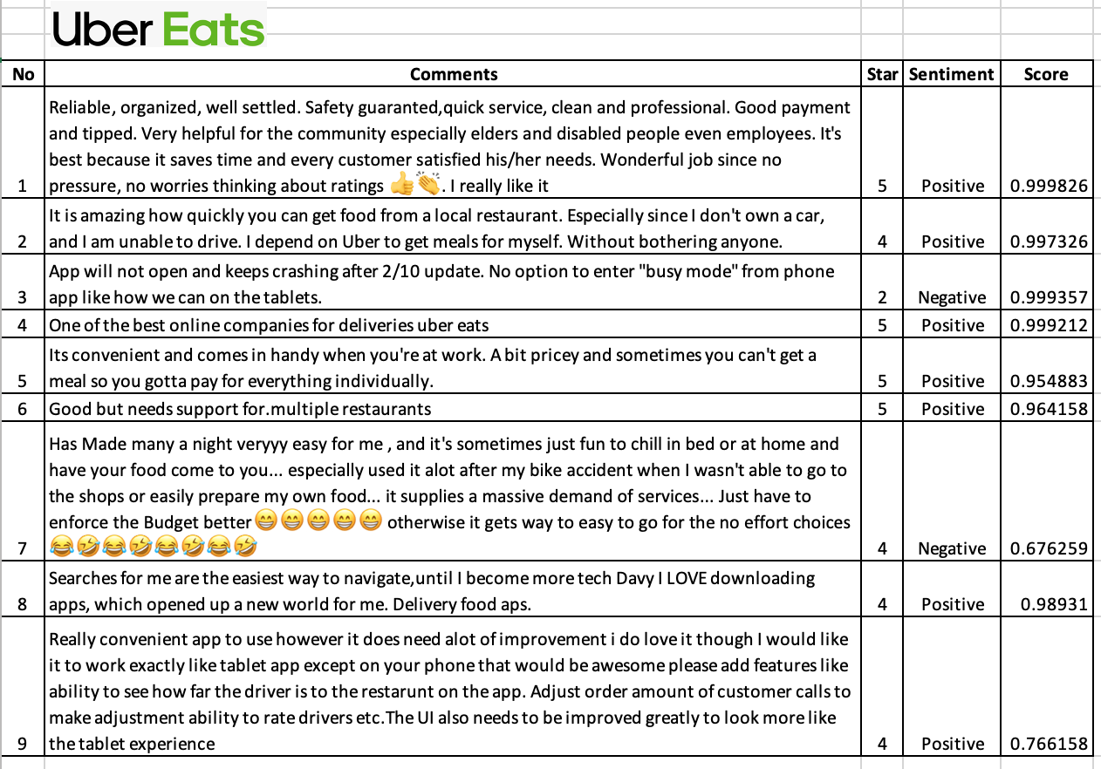
It’s 62/100 of the positive, 38/100 of the negative

Slide 16
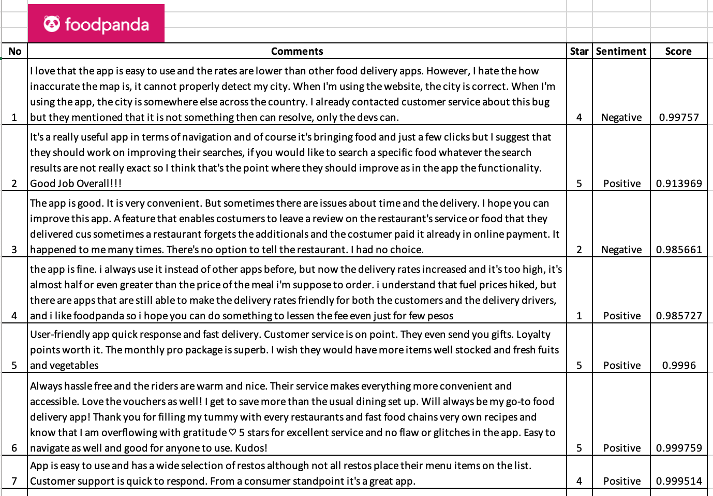
It’s 70/100 of the positive, 30/100 of the negative

Slide 17
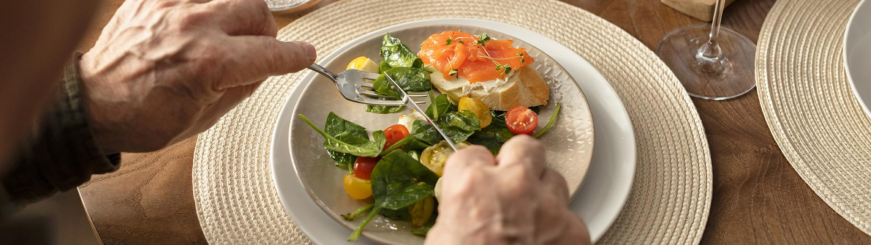
the result is
17

Slide 18
Customer sentiment results
100
$550,000
100
200
2018
2019
2020
2021
Gross revenue in 2021
Uber Eats
Food Panda
Total
18

Slide 19



inconsistent with the actual comments
8%
6%
7%
8/100 results inconsistent with the actual comments
6/100 results inconsistent with the actual comments
14/200 results inconsistent with the actual comments
19

Slide 20
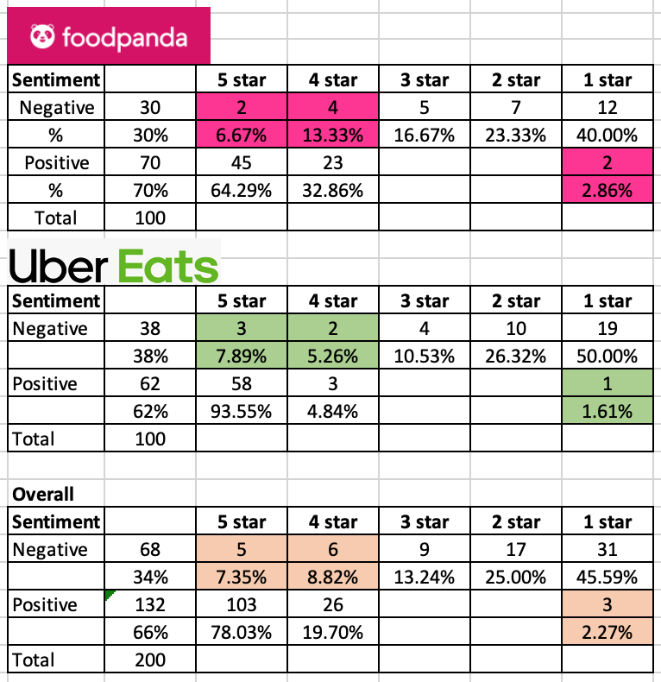



8/100 results inconsistent with the actual comments
6/100 results inconsistent with the actual comments
14/200 results inconsistent with the actual comments

Slide 21
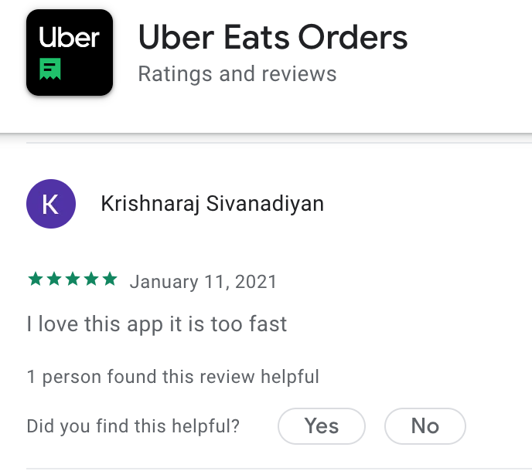
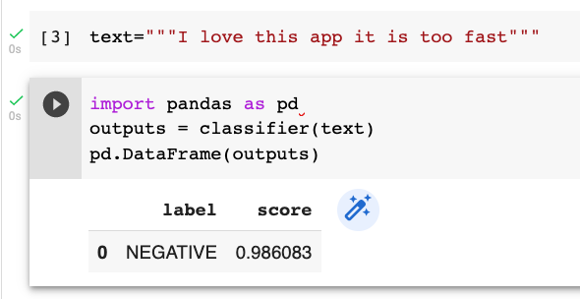

THEM
US
Mercury is the closest planet to the Sun and the smallest one in the Solar System—it’s only a bit larger than the Moon
Venus has a beautiful name and is the second planet from the Sun. It’s hot and has a poisonous atmosphere
21

Slide 22
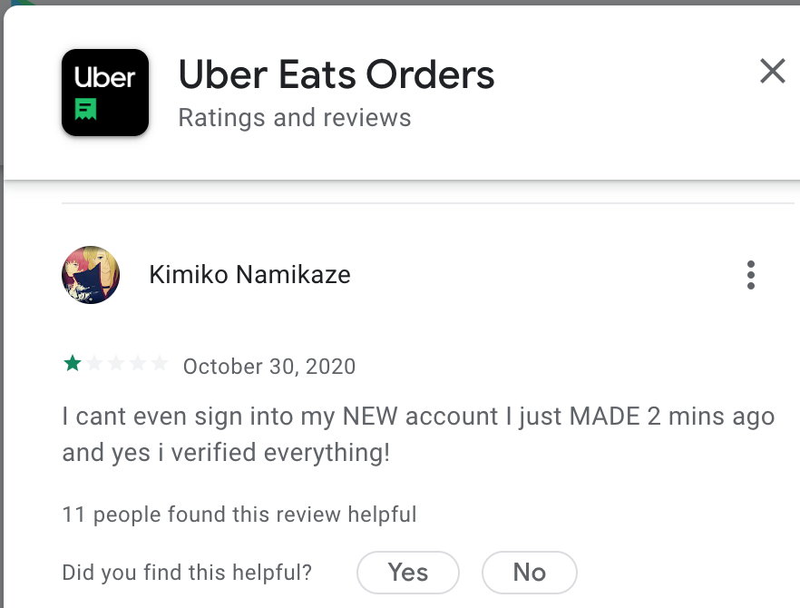
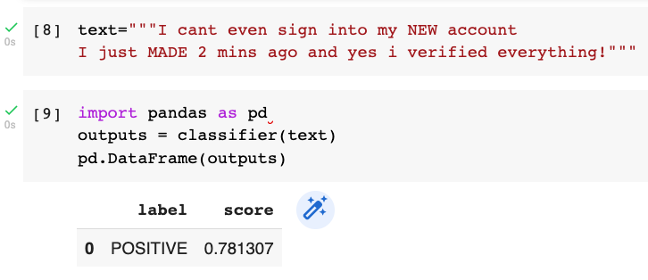
THEM
US
Mercury is the closest planet to the Sun and the smallest one in the Solar System—it’s only a bit larger than the Moon
Venus has a beautiful name and is the second planet from the Sun. It’s hot and has a poisonous atmosphere
22

Slide 23
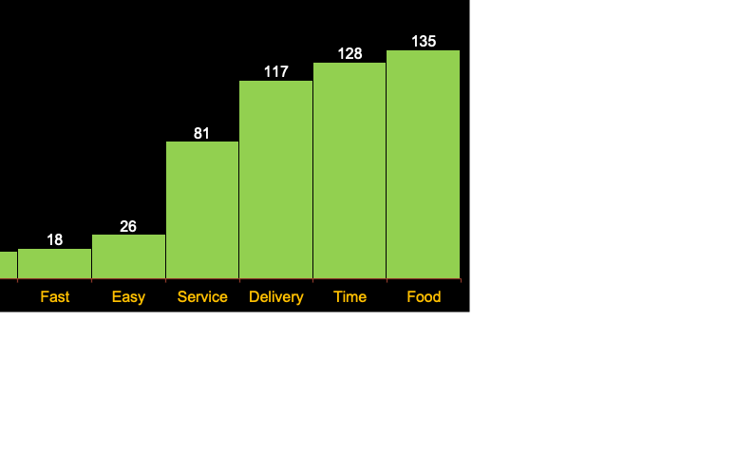
What do customers care about?
100
$550,000
100
200
2018
2019
2020
2021
Gross revenue in 2021
Uber Eats
Food Panda
Total
23

Slide 24
04
IMPLICATION
find out the appropriate solutions
24

Slide 25
Support the firm leaders
improve products and services
measure, manage and improve customer satisfaction
create the best customer experience
improve customer retention
taking business decisions
detect poor service and excluded from their business.
25

Slide 26

This report marks that I have gained a lot of knowledge during the Artificial Intelligence for Text Analytics course, and I believe that what I have learned will enhance my career afterward
26

Slide 27

References
GitHub:
https://github.com/Sophie315/fooddeliveryapp
27

Slide 28
Using NLP with Transformers Analyze customer satisfaction for Uber Eats and Food Panda apps
Professor Min-Yuh Day
soPHIe
Artificial Intelligence for Text Analytics Course
Q&A
thanks!
Institute of Information Management, NTPU
GMBA in Finance, NTPU
Student’s ID: 710937132
31 May 2022
28

